Slide 1


ECEN 403
Status Update Presentation
Matrix 1/Scooter Juice
Connor Cottongame
John Dusterhoff
Blake Hallam
Oscar Rubio
TA: Hailey Ward
Sponsor: Dr. Enjeti

Slide 2
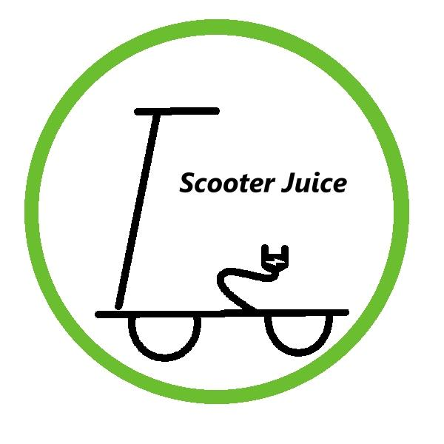

Project Summary
Problem statement:
Current electric scooter chargers are bulky and inconvenient to use, requiring large, external rectifiers to charge their batteries, much like a laptop charger.
Our Solution:
This team will design and build an IOBC (Integrated On-Board Charger), allowing the scooter to be charged directly from an AC power source.
This charger will use the existing inverter components in the scooter as a rectifier in order to charge the battery.

Slide 3
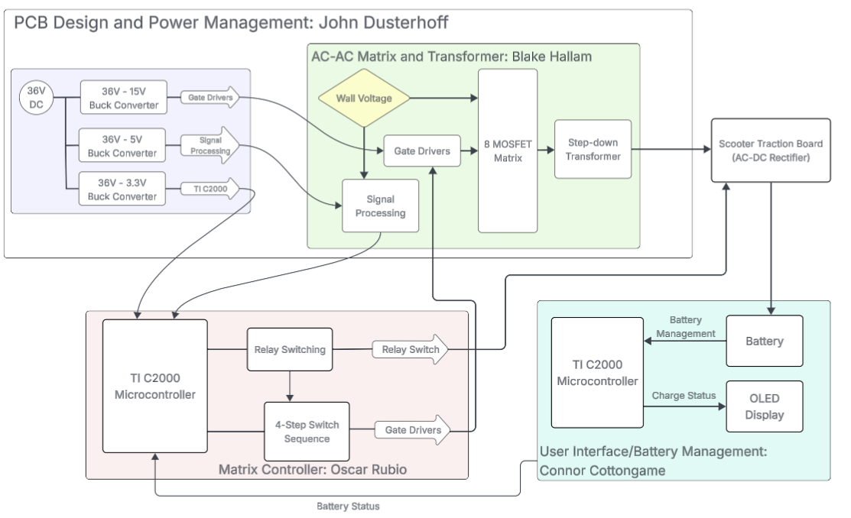
System Overview
Notes:
Cloud server and database

Slide 4
AC-AC Converter and Transformer
Blake Hallam
Accomplishments since midterm update 20 hrs of effort | Ongoing progress/problems and plans until the next presentation
Schematic in Altium Designer completed and provided to John to complete the PCB. All component selections finalized. Bill of Materials completed. Completed building the transformer, and conducted initial tests. | Finish testing the transformer. Soldering all components to the PCB and testing incrementally. Debug/implement improvements or corrections where needed.

Slide 5
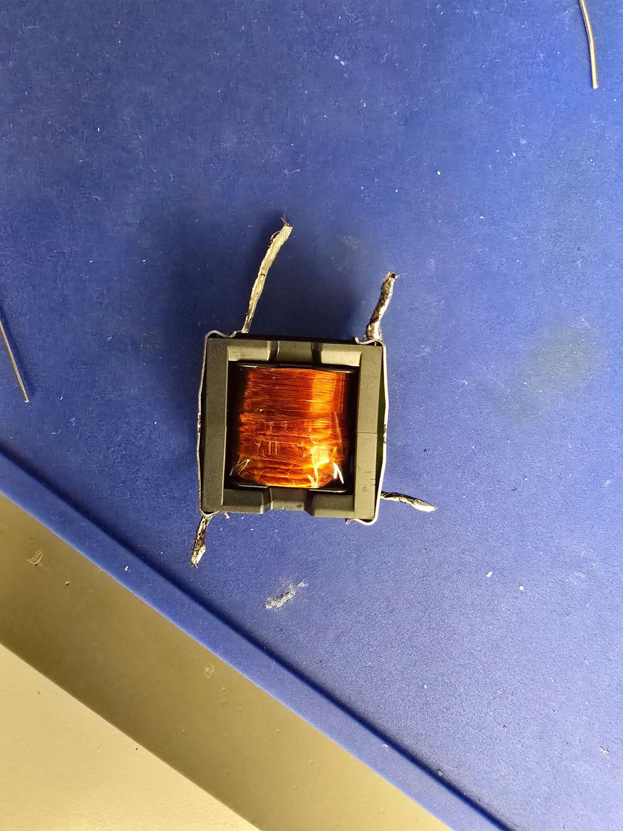
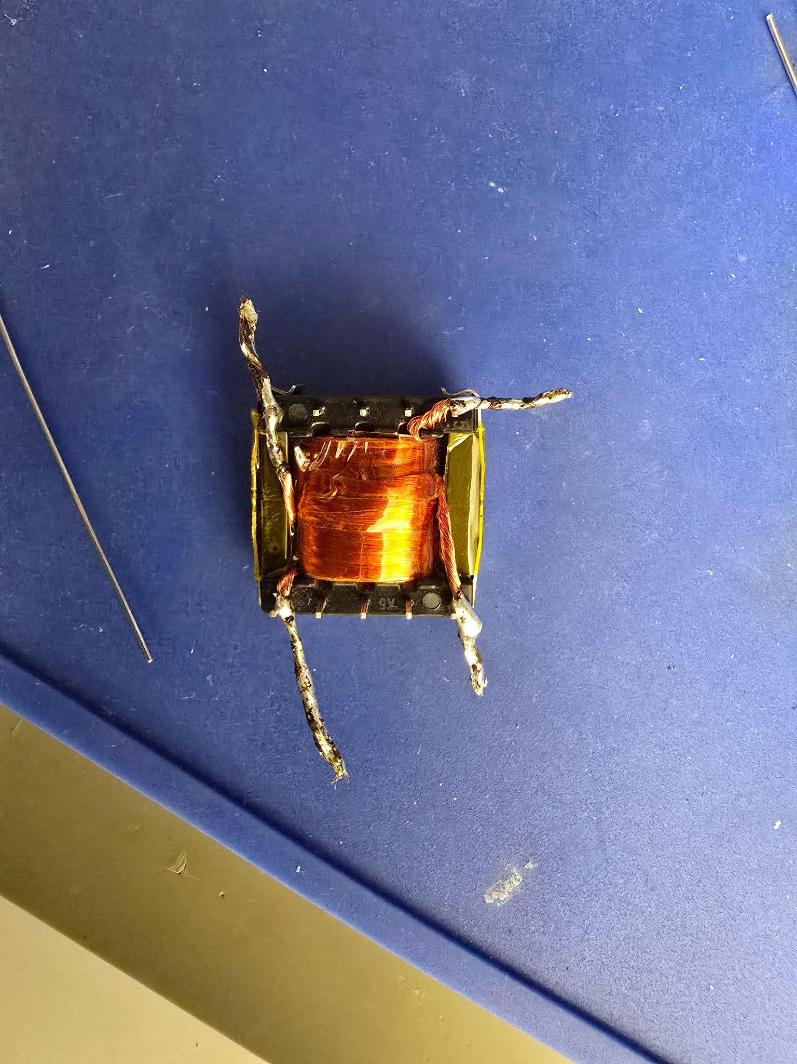
AC-AC Converter and Transformer
Blake Hallam

Slide 6
Matrix Control System
Oscar Rubio
Accomplishments since midterm update 20 hrs of effort | Ongoing progress/problems and plans until the next presentation
The C code for relay switching has been completed and test with microsecond delay to simulate possible real time delay The C code for 4-step switch sequence is completed and tested to verify proper logic sequence Configurable Logic Blocks (CLBs) input and output configuration has been tested using basic digital logic on LaunchPad-XL | Build the CLB tiles for 4-step switch sequence logic Finish building and test the Control Unit CLB tile that will detect inputs and determine the proper sequence needed Design the counter for 200ns delay between switch steps

Slide 7
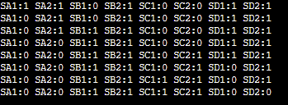

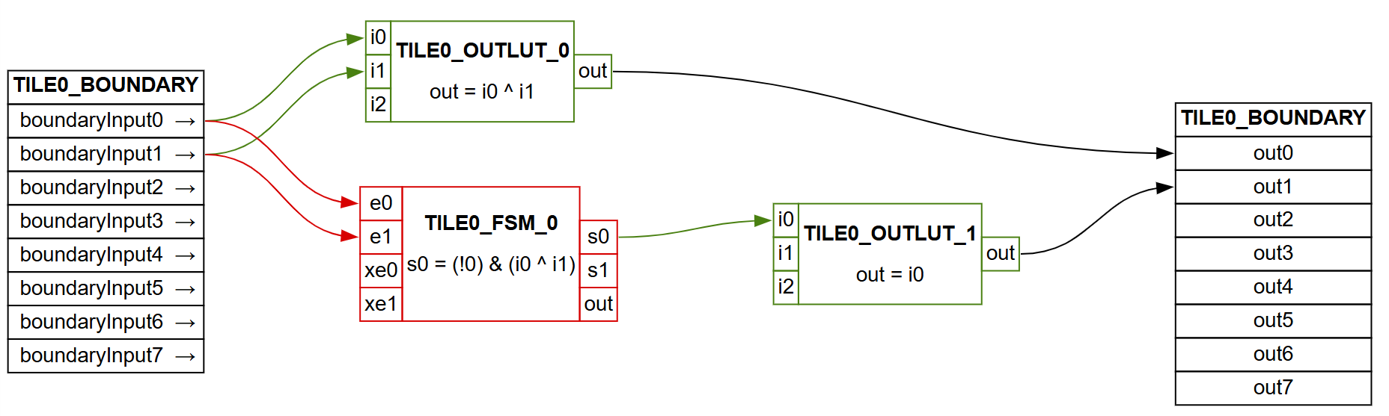
Matrix Control System
Oscar Rubio

Slide 8
Microcontroller Programming
Connor Cottongame
Accomplishments since midterm update 20 hrs of effort | Ongoing progress/problems and plans until the next presentation
Completed portable C TPS implementation of all 3 operating regions, utilized Newton-Raphson solver with bisection fallback, 20-iteration max, 1E-6 tolerance; boundary functions implemented PI Voltage Controller (Kp = 0.5 Ki = 300, 10kHz) (8.2% overshoot, 7.3ms settling, 0% steady-state error) | BLDC Motor control code Implement I2C display user interface (charge status, mode, etc) UART BMS communication

Slide 9
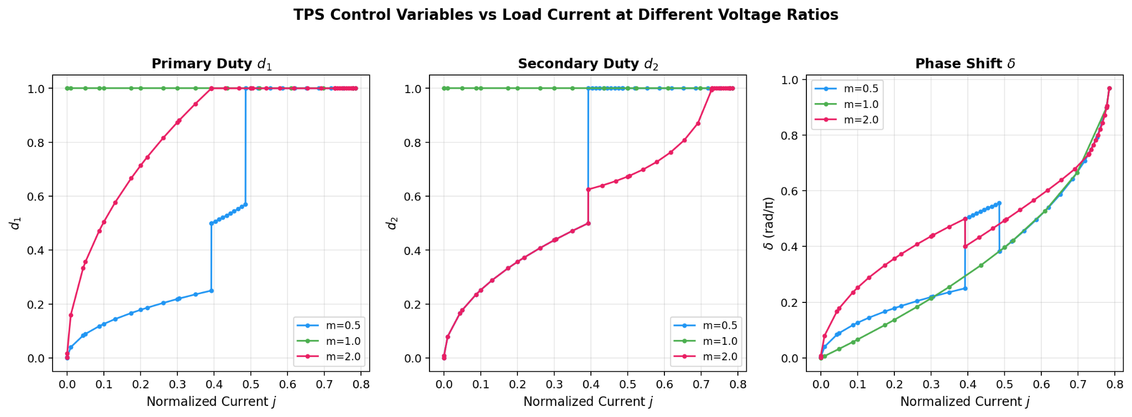
Microcontroller Programming
Connor Cottongame

Slide 10
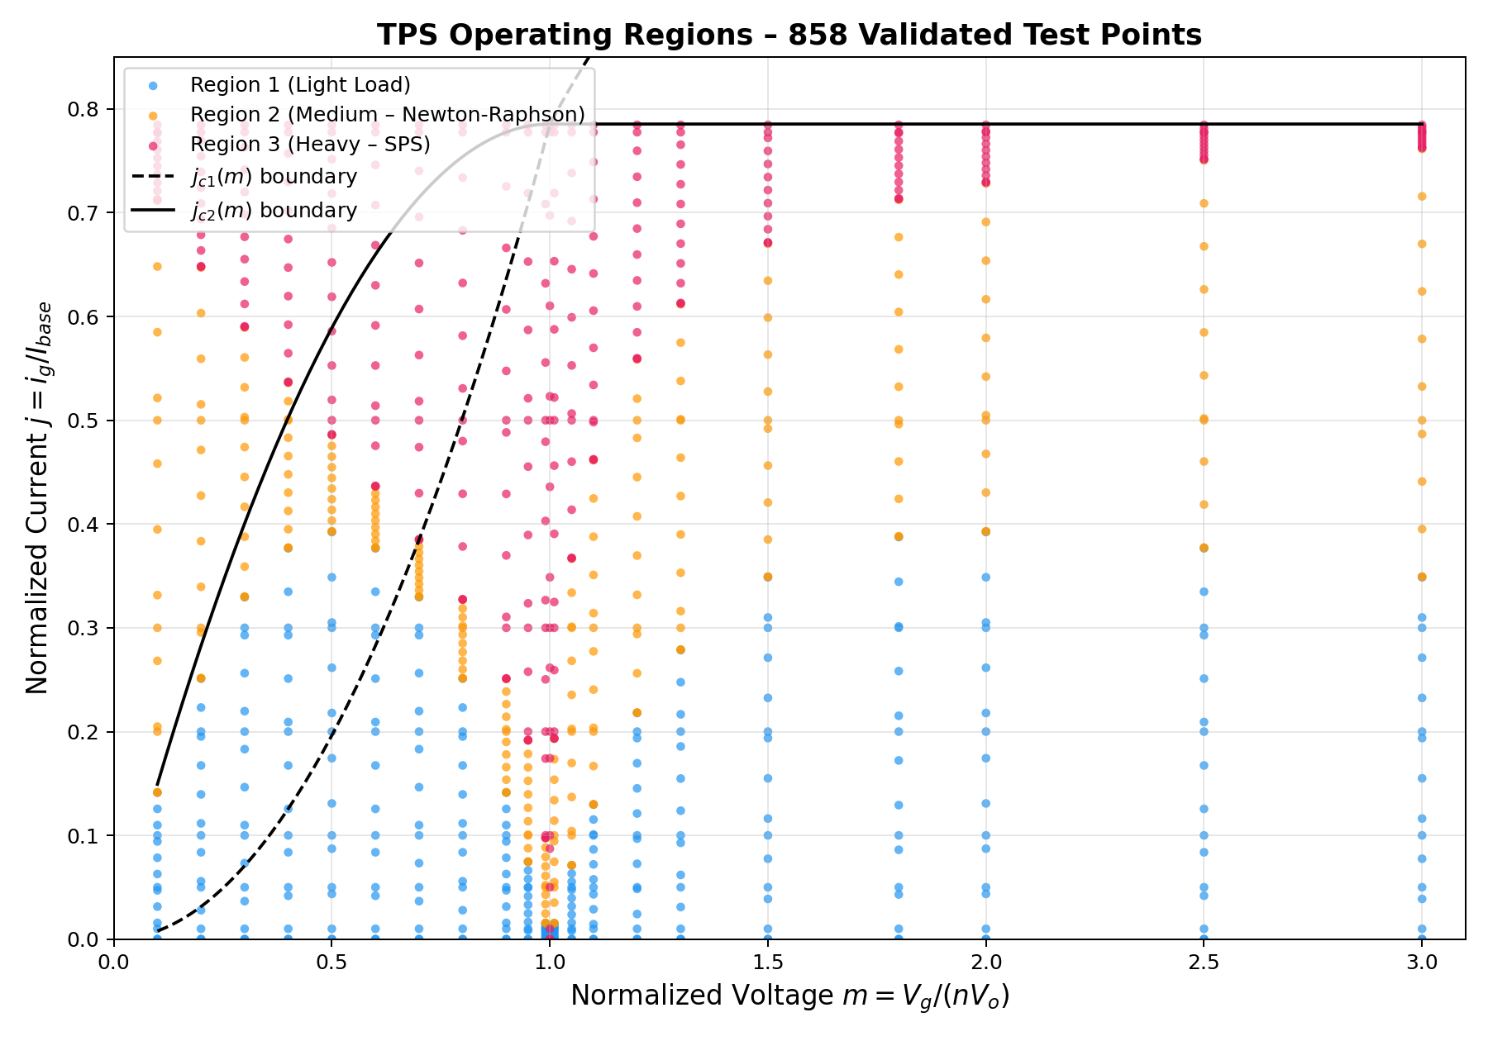
Microcontroller Programming
Connor Cottongame

Slide 11
PCB Design
John Dusterhoff
Accomplishments since midterm update 20 hrs of effort | Ongoing progress/problems and plans until the next presentation
Power buck converter schematic completed, allowing for 3 rails of power, 15V, 5V, and 3.3V Power buck PCB design also completed with custom footprints, passing all DRC checks and matching with the schematic Altium workspace and backups created in order to more efficiently work within the team as the project reaches its final steps | Converting the AC-AC converter + transformer schematic into a PCB design Starting the layout of the how the FPGA/MCU development board will interact with the rest of the PCB Piecing together of all subsystems into one completed board for manufacturing

Slide 12
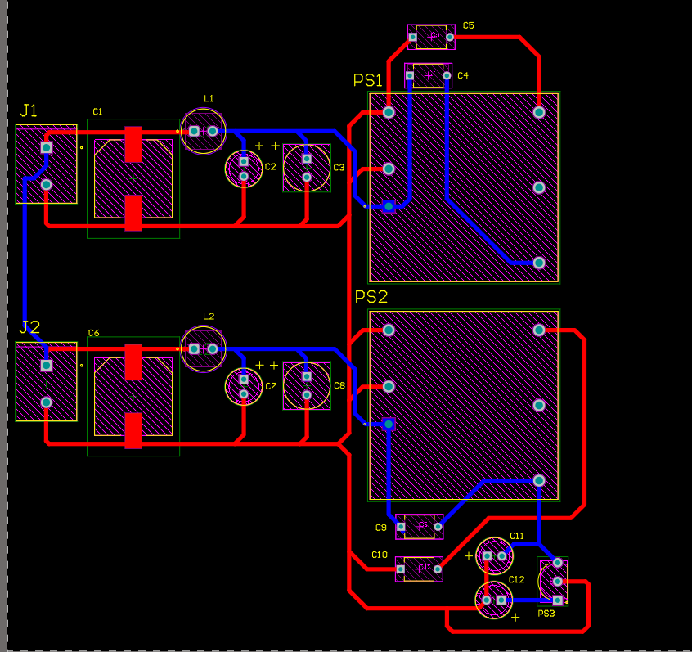
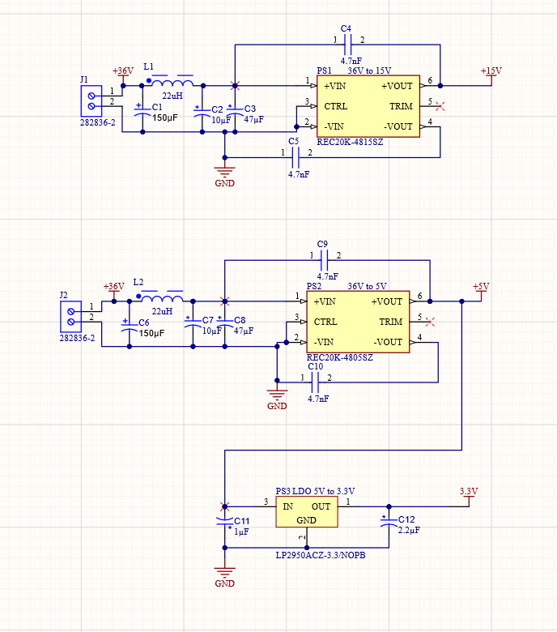
PCB Design
John Dusterhoff

Slide 13
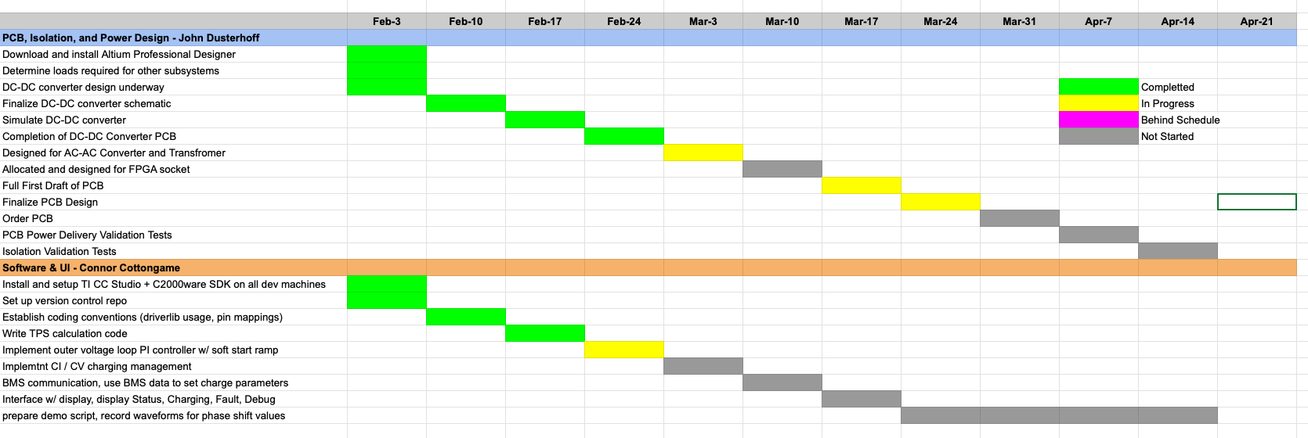
Execution
‹#›

Slide 14
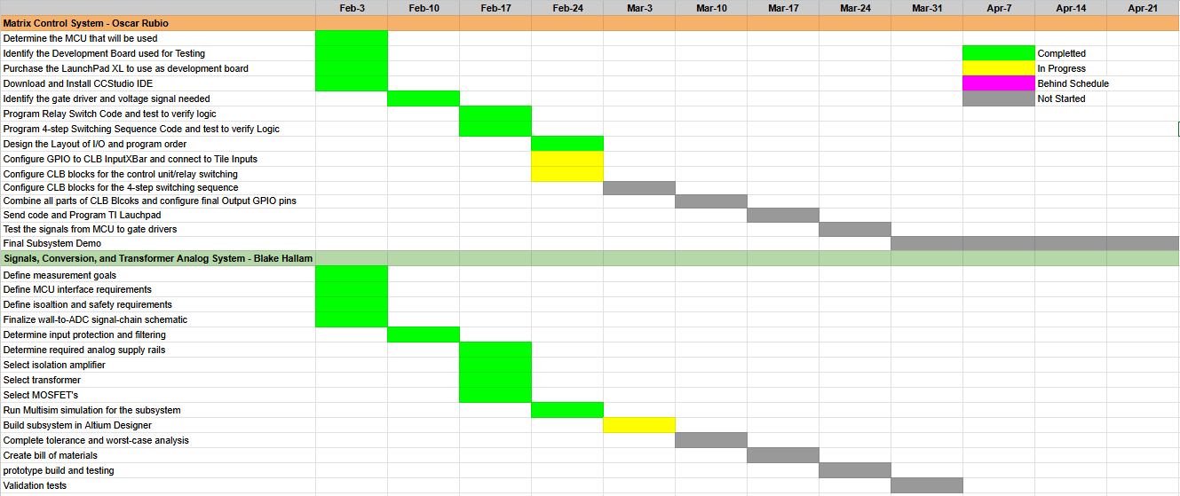
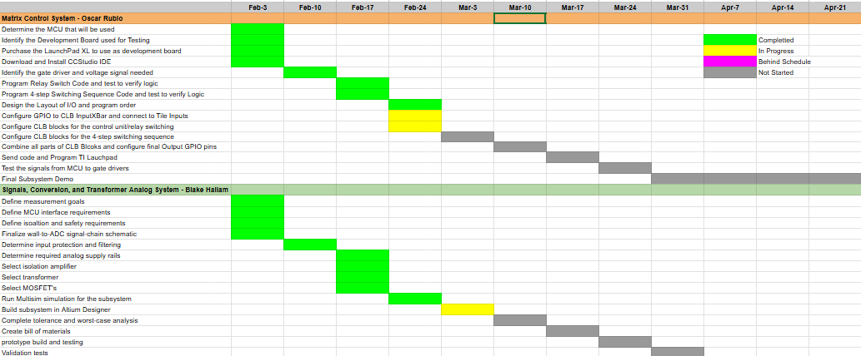
Execution
‹#›

Slide 15
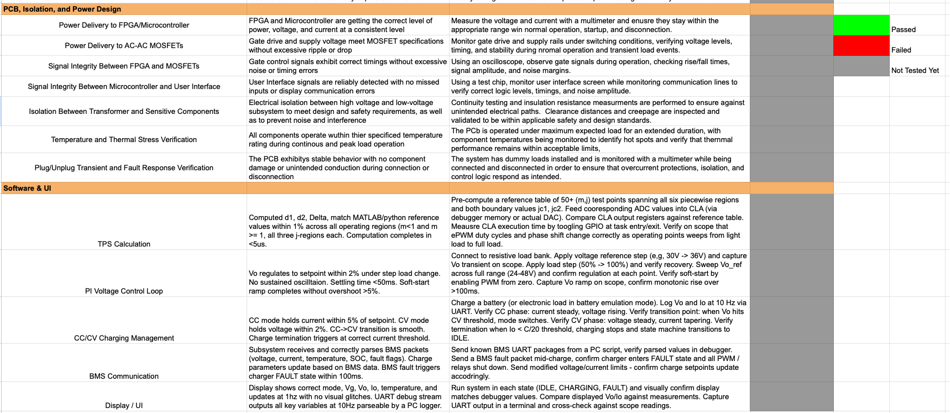
Validation plan
‹#›

Slide 16
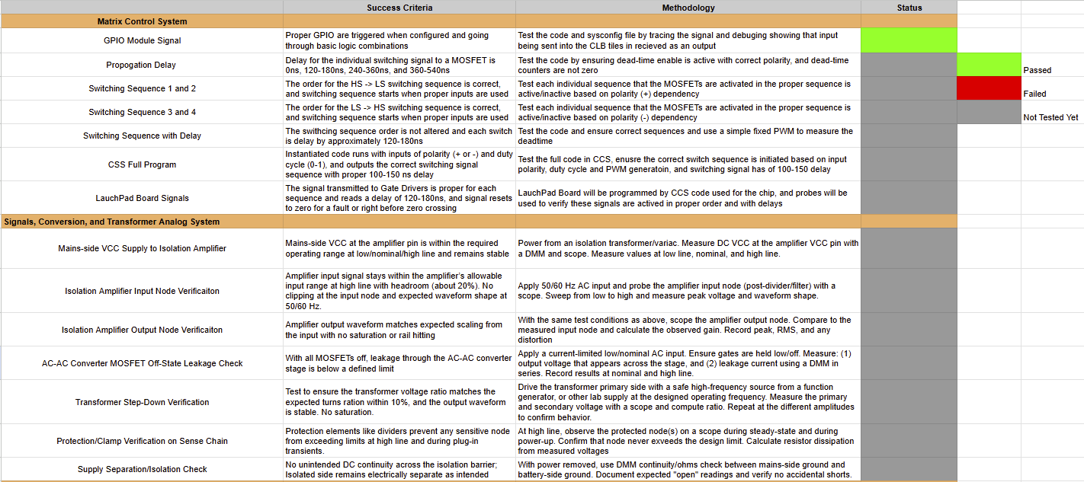
Validation plan
‹#›

Slide 17
From Matrix 1/Scooter Juice we thank for your attention.
Any Questions?
‹#›

